Slide 2
Practical Help for More Effectively Sharing Our Faith
A Special Sunday Message
Mark 1:14-20
© April 30, 2017
Wade Harlan
Notes:
2

Slide 3
REVIEW OF THE HELPFUL POINTS ABOUT EVANGELISM
Lack of sharing our faith causes us and the church to miss out on much joy and many blessings.
"I pray that you may be active in sharing your faith, so that you will have a full understanding of every good thing we have in Christ.” (Philemon 1:6 )
“The happiest Christians I know are those that regularly share their faith!”
Ying Kai
“The most alive churches I’ve been around are those where the
members are intentional about regularly sharing their faith.”
Notes:
My goal is to encourage, in China its very different., Xmas, Easter, how to get God’s blessing, don’t have to win a hearing (guy invited to hear friend presentation on why buy a certain brand of tampons.
Often because they have the wrong goal.

Slide 4
REVIEW OF THE HELPFUL POINTS ABOUT EVANGELISM
A good definition of success in evangelism can make a radical difference!
“Success in evangelism is sharing truth about God by the leading and power of the Holy Spirit and leaving the results to GOD.”
Notes:
Truth – our testimony, praying for you, “just part of the gospel,
Leading of the HS = Listening rather than compelled to get through presentation, the messenger is the message
What an incredible joy, privilege to be able to sensitively share the gospel with someone! In China, didn’t know if would be turned in, so HAD to rely on HS. The same here! The joy is in doing it by the leading & power of the HS.

Slide 5
REVIEW OF THE HELPFUL POINTS ABOUT EVANGELISM
A good analogy for evangelism can make a radical difference!
The “Peas on a scale” analogy
- Helps us see that every touch counts and that sowing is the hard work.
³⁵Do you not say, ‘There are yet four months, then comes the harvest’? Look, I tell you, lift up your eyes, and see that the fields are white for harvest. ³⁶Already the one who reaps is receiving wages and gathering fruit for eternal life, so that sower and reaper may rejoice together. ³⁷For here the saying holds true, ‘One sows and another reaps.’ ³⁸I sent you to reap that for which you did not labor. Others have labored, and you have entered into their labor.” Others have done the hard work, and you have reaped the benefits of their labor.”
John 4: 35-38
Notes:
Average of 29 touches, celebrate each one.
Many discouraged (to the point of giving up) if haven’t led anyone to Christ, but faithfulness is key.

Slide 6
REVIEW OF THE HELPFUL POINTS ABOUT EVANGELISM
God sees us as especially beautiful when we share our faith
¹⁴ How, then, can they call on the one they have not believed in? And how can they believe in the one of whom they have not heard? And how can they hear without someone preaching to them? ¹⁵ And how can they preach unless they are sent? As it is written, “How beautiful are the feet of those who bring good news!” Romans 10:14-15 (NIV 1984)
Notes:
If this is what the scripture says about our feet then how much the more favored parts of our body? TMI, my toenails funky shape, one heel serious callous, then it will peal like crazy, athlete’s feet. So someone tells me my feet are beautiful – woo hoo! That would be a blessing!

Slide 7
REVIEW OF THE HELPFUL POINTS ABOUT EVANGELISM
We must always show gentleness and respect to those we share our faith with.
¹⁵…but in your hearts honor Christ the Lord as holy, always being prepared to make a defense to anyone who asks you for a reason for the hope that is in you; yet do it with gentleness and respect, ¹⁶having a good conscience, so that, when you are slandered, those who revile your good behavior in Christ may be put to shame.
1 Peter 3:15-16
Notes:
When (not if) you are slandered, you can have no guilt, can keep your chin up

Slide 8
HOW WE RATED OURSELVES ON SHARING OUR FAITH
very
poorly poorly so so well very well
1 2 3 4 5
2.4
no slight average great
success success success success success
Notes:
Just think of the increased joy and blessing if that 2.4 was 3.4 or 4.4! Don’t want to become proud.
Better to evaluate in terms of our definition of success. Sharing truth about God by the power & leading of the HS and leaving the results to God.
Imagine the joy to be able to say “by God’s grace I’ve very success in sharing truth about God…..!!!!”

Slide 9
BECOMING FISHERS OF MEN/WOMEN
Jesus said, “Come follow me and I’ll make you fishers of men.”
”Come follow me and I’ll make you good at influencing people to become followers of me.”
A hard question:
If we are not good at influencing people to become followers of Christ, could it be that we are not following Him well?
Could it be that we’re not following Him as well as we should?
Notes:
In praying about sharing more about EV, God led me to two passages. Fishing for men ot just converting, but making disciples.
This was a hard question for me.

Slide 10
BECOMING FISHERS OF MEN/WOMEN
5 “I am the vine; you are the branches. If a man remains in me and I in him, he will bear much fruit; apart from me you can do nothing. 6 If anyone does not remain in me, he is like a branch that is thrown away and withers; such branches are picked up, thrown into the fire and burned. 7 If you remain in me and my words remain in you, ask whatever you wish, and it will be given you. 8 This is to my Father’s glory, that you bear much fruit, showing yourselves to be my disciples.”
John 15:5-8 (NIV 1984)
A hard question:
If we’re not bearing much fruit, could it be that we’re not abiding in Christ very well?
Notes:
Fruit is not just converts, but converts certainly would be part of it. Includes character and everything we do that shows that we love and seek to honor God. Not abiding as well as we should. H udsonTaylor “The hardest part of the missionary life is found in maintaining daily hourly fellowship with him and this comes through regular times of prayer and in the Word. Satan will often have us doing other things when we ought to be about these.

Slide 11
Advice From Dr. Thom Wolf
“Turn around and write it down.”
Turn around = small group’s primary orientation
Write it down = write down and pray with accountability partner for three people you want to see come to Christ.
Notes:
Food for thought and prayer – not scripture
Linda Wolf – 20% of the church’s growth came from her Life Groups – they were always outward focused. Had the least internal conflicts but were vibrant with everyone talking of how God was at work in other’s lives and planning ways to connect non-believers w/ believers.

Slide 12
Learn From Chris Crossan
Precision Harvesting =
looking for and investing in those that appear to be responsive
Notes:
Food for thought and prayer – not scripture
Linda Wolf – 20% of the church’s growth came from her Life Groups – they were always outward focused. Had the least internal conflicts but were vibrant with everyone talking of how God was at work in other’s lives and planning ways to connect non-believers w/ believers.

Slide 13
x x x x x x x x x x x x x x x x x x x x x x x x x x x x x x x x x x x x x x x x x x x x x x x x x x x x x x x x x x x x x x x x x x x x x x x x x x x x x
x x x x x x x x x x x x x x x x x x x x x x x x x x x x x x x x x x x x x x x x x x x x x x x x x x x x x x x x x x x x x x x x x x x x x x x x x x x x x x x x x x x x x x x x x x x x x x x x x x x x x x x x x x x x x x x x x x x x x x x x x x x x x x x x x x x x x x x x x x x x x x x x x x x x x x x x x x x x x x x x x x x x x x x x x x x x x x x x x x x x x x x x x x x x x x x x x x x x x x x x x x x x x x x x x x x x x x x x x x x x x x x x x x x x x
x x x x x x x x x x x x x x x x x x x x

Slide 14
x x x x x x x x x x x x x x x x x x x x x x x x x x x x x x x x x x x x x x x x x x x x x x x x x x x x x x x x x x x x x x x x x x x x x x x x x x x x x
x x x x x x x x x x x x x x x x x x x x x x x x x x x x x x x x x x x x x x x x x x x x x x x x x x x x x x x x x x x x x x x x x x x x x x x x x x x x x x x x x x x x x x x x x x x x x x x x x x x x x x x x x x x x x x x x x x x x x x x x x x x x x x x x x x x x x x x x x x x x x x x x x x x x x x x x x x x x x x x x x x x x x x x x x x x x x x x x x x x x x x x x x x x x x x x x x x x x x x x x x x x x x x x x x x x x x x x x x x x x x x x x x x x x x
x x x x x x x x x x x x x x x x x x x x

Slide 15
x x x x x x x x x x x x x x x x x x x x x x x x x x x x x x x x x x x x x x x x x x x x x x x x x x x x x x x x x x x x x x x x x x x x x x x x x x x x x
x x x x x x x x x x x x x x x x x x x x x x x x x x x x x x x x x x x x x x x x x x x x x x x x x x x x x x x x x x x x x x x x x x x x x x x x x x x x x x x x x x x x x x x x x x x x x x x x x x x x x x x x x x x x x x x x x x x x x x x x x x x x x x x x x x x x x x x x x x x x x x x x x x x x x x x x x x x x x x x x x x x x x x x x x x x x x x x x x x x x x x x x x x x x x x x x x x x x x x x x x x x x x x x x x x x x x x x x x x x x x x x x x x x x x
x x x x x x x x x x x x x x x x x x x x

Slide 16
Learn From Chris Crossan
Precision Harvesting =
looking for and investing in those that appear to be responsive
Notes:
Food for thought and prayer – not scripture
Linda Wolf – 20% of the church’s growth came from her Life Groups – they were always outward focused. Had the least internal conflicts but were vibrant with everyone talking of how God was at work in other’s lives and planning ways to connect non-believers w/ believers.

Slide 17
Pray for and Look for a Person Of Peace
Go; behold, I send you out as lambs in the midst of wolves.
4 Carry no money belt, no bag, no shoes; and greet no one on the way.
5 Whatever house you enter, first say, ‘Peace be to this house.’ 6 If a man
of peace is there, your peace will rest on him; but if not, it will return to you.
7 Stay in that house, eating and drinking what they give you; for the laborer is worthy of his wages. Do not keep moving from house to house. 8 Whatever city you enter and they receive you, eat what is set before you; 9 and heal those in it who are sick, and say to them, ‘The kingdom of God has come
near to you.’ 10
Luke 10:3-10 (NASB)
Notes:
Food for thought and prayer – not scripture
Linda Wolf – 20% of the church’s growth came from her Life Groups – they were always outward focused. Had the least internal conflicts but were vibrant with everyone talking of how God was at work in other’s lives and planning ways to connect non-believers w/ believers.

Slide 18
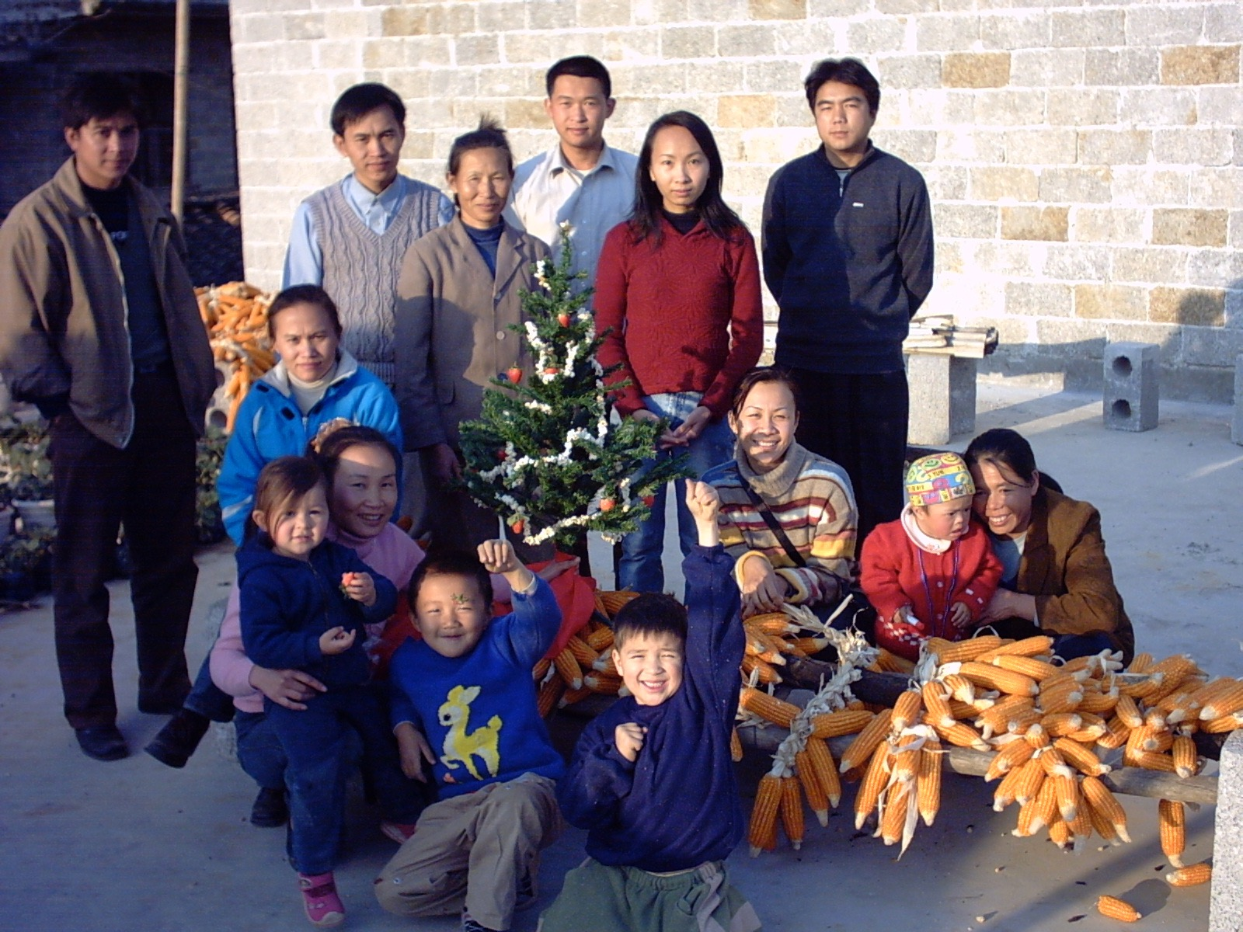
Notes:
Zaccheus, Priscilla & Aquila, Matthew (Levi), Cornelius

Slide 19
REASONS WE DON’T SHARE OUR FAITH MORE
Lack of boldness
Lack of confidence/proficiency
Laziness/lack of motivation
I don’t know how to make the gospel relevant and appealing?
I don’t know how to present the Gospel in a natural, casual, personal way.
I'm afraid of appearing hypocritical
There aren’t many non-Christians that I know or hang out with anymore.

Slide 20
REASONS WE DON’T SHARE OUR FAITH MORE
Lack of boldness
is helped by prayer.
² Devote yourselves to prayer, being watchful and thankful. ³ And pray for us, too, that God may open a door for our message, so that we may proclaim the mystery of Christ, for which I am in chains. ⁴ Pray that I may proclaim it clearly, as I should.
Colossians 4:2-4 (NIV 1984)
Notes:
But fear is exactly the problem keeping so many of us from sharing.

Slide 21
REASONS WE DON’T SHARE OUR FAITH MORE
Lack of confidence/proficiency
Practice! It builds confidence.
² Devote yourselves to prayer, being watchful and thankful. ³ And pray for us, too, that God may open a door for our message, so that we may proclaim the mystery of Christ, for which I am in chains. ⁴ Pray that I may proclaim it clearly, as I should.
Colossians 4:2-4 (NIV 1984)
Notes:
But fear is exactly the problem keeping so many of us from sharing.

Slide 22
REASONS WE DON’T SHARE OUR FAITH MORE
Laziness/lack of motivation
Notes:
People are missing out on God’s wisdom, love, comfort, etenal life
More that we’re discouraged by rejection, being thought of as weird, religious nut, spiritual battle
A little accountability – help me do what I want to do.

Slide 23
REASONS WE DON’T SHARE OUR FAITH MORE
I don’t know how to make the gospel relevant and appealing?
Three most common cultural orientations
Honor/Shame
Power/Fear
Righteousness/Guilt
Notes:
Practice, listen to others, adapt, IV – restore relationship w/ creation, God, others
- The messenger is the message - Pick out the aspect of the gospel that appeal to that person culture, Zhuang – power/fear Honor shame/, righteousness/guilt, curse, equality, eternal life, spiritual power, community, preiesthood of the believer, Relevant – watch your vocabulary, washed in the blood, sanctified,

Slide 24
REASONS WE DON’T SHARE OUR FAITH MORE
I don’t know how to present the Gospel in a natural, casual, personal way.
Notes:
Relationship EV, Listening, asking Good questions of the person

Slide 25
REASONS WE DON’T SHARE OUR FAITH MORE
I'm afraid of appearing hypocritical
Notes:
Be humble and real, this is winsome. Mistakes were made, own up, I fail to consistently live up to the kind of righteous life th Jesus modeleled for us to live,, but I’m grateful for his forgiveness

Slide 26
REASONS WE DON’T SHARE OUR FAITH MORE
There aren’t many non-Christians that I know or hang out with anymore.
Notes:
Within 6 mo – 2 years 90-95% of a new Christians circle of friends he spends time with is made up of other Christians,

Slide 27
SOME COMMON QUESTIONS
Many of those I’ve talked with about Christianity say they can’t believe in a God that would allow such horrible evil in the world.
Notes:
Can’t have true love w/o free will to choose. We should point our finger at ourselves not God for the evil, Christians have made a real positive impact in the world, Richard Woodbury,
What’s stunning, mind-boggling is not the evil but that God would enter into it.

Slide 28
PRACTICAL HELP FOR MORE EFFECTIVELY SHARING OUR FAITH
Possible Applications:
Begin praying daily for the three people you and your accountability partner want to see come to know the Lord. Take time to pray for these non-Christians each time your men’s/women’s group meet.
Plan a men’s/women’s group event specifically to plant a seed with an unsaved friend of someone.
Have an acquaintance, work colleague, or unsaved friend over for dinner.
Invite Helen and I to come do two one-hour seminars on parenting or marriage during your lunch hour.
Contact Prison Fellowship about visiting someone in a local prison who is from Santa Ana or Orange county.
Notes:
Or we’ll give you our notes and you can do it, or Paul & Kate

Slide 29
PRACTICAL HELP FOR MORE EFFECTIVELY SHARING OUR FAITH
Possible Applications: (continued)
6. Encourage others in your men’s/women’s group by sending a group email whenever you're obedient to planting a seed by the leading of the Holy Spirit and left the result to God!
Notes:
Just throw out bait. Saw a great movie The Good Lie on refugees. Our church recently adopted… At church we just had a creationist come talk about the evidence for why we should believe in God. At church we sometimes have lunch one-on-one with youth in our church to get to know them better. Sunday was a bit crazy – we provided lunch for 120 people! You see at church we take turns.

Slide 30
THREE PRACTICAL QUESTIONS FOR OUR EVERYDAY LIVES
What about today’s message was most helpful to you?
Which was more helpful to you: the definition for success in evangelism or the analogy for evangelism? Why?
What do I feel led to do differently or to work on when it comes to sharing your faith.

